Slide 1

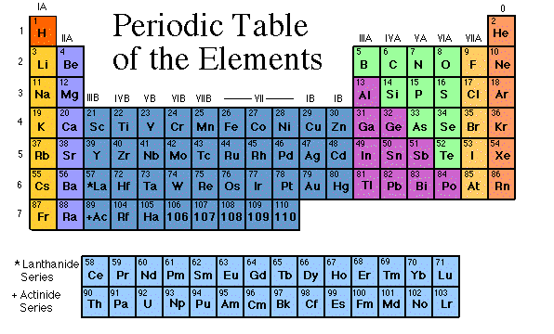

Slide 2

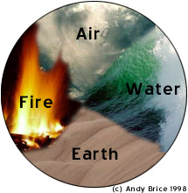
Science has come along way since Aristotle’s theory of Air, Water, Fire, and Earth.
Scientists have identified 92 Natural elements, and created about 28 others.

Slide 3


The elements, alone or in combinations, make up our bodies, our world, our sun, and in fact, the entire universe.

Slide 4

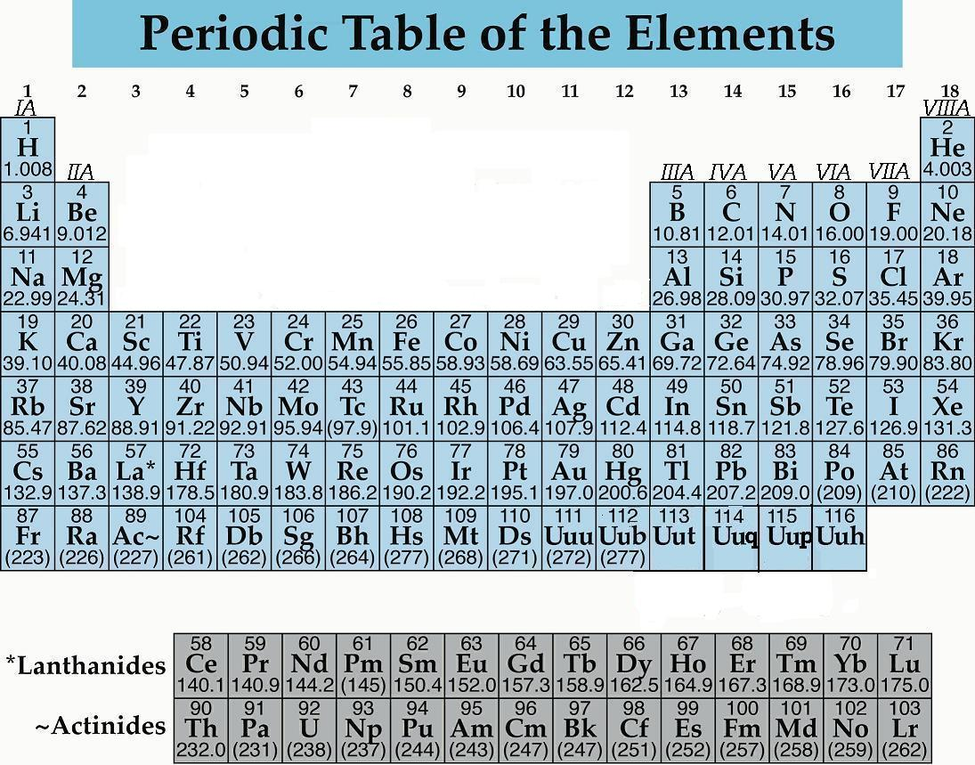
A great deal of information about an element can be gathered from its position on the period table.
Understanding the organization and plan of the periodic table will help you obtain basic information about each of the 118 known elements.

Slide 5

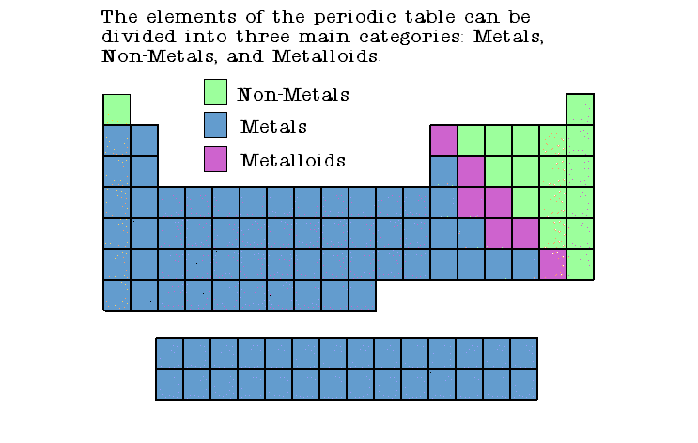

Slide 6

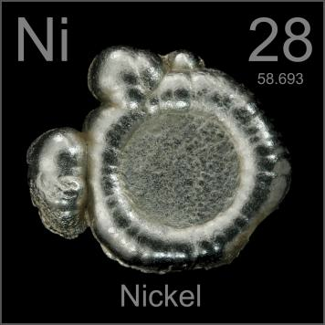
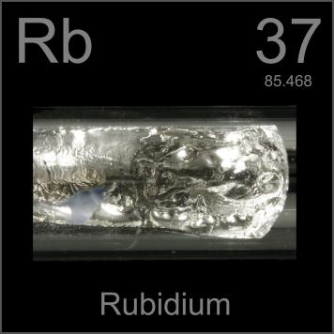
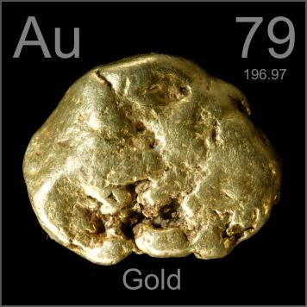
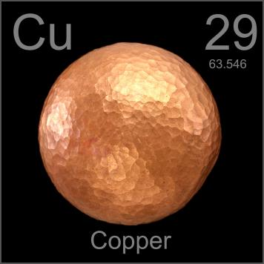

Slide 7

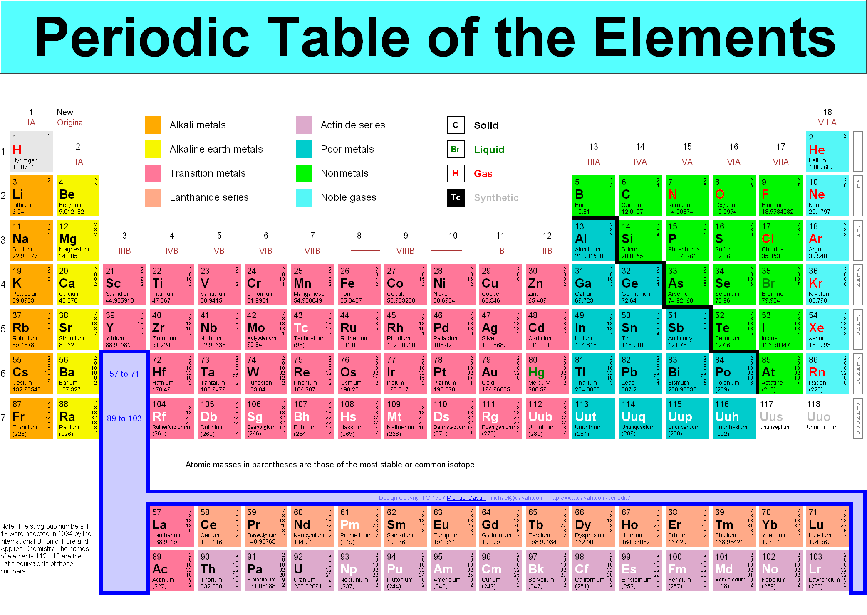
Metals appear to the left of the dark ziz-zag line on the periodic table.
Most metals are solid at room temperature.

Slide 8

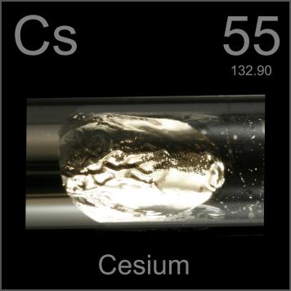
Metals have luster. This means they are shiny

Slide 9

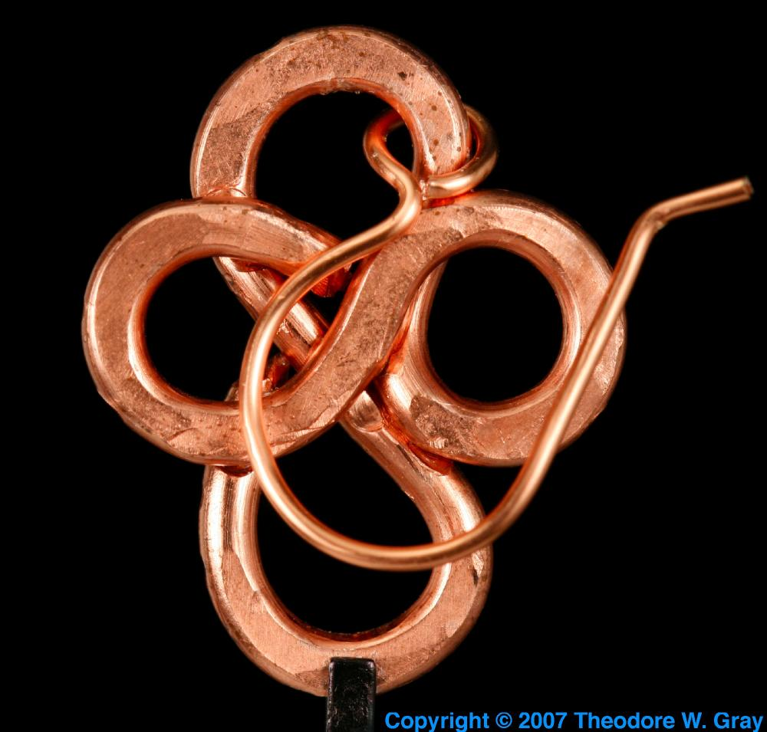
Ductile
metals can be drawn into wire.

Slide 10
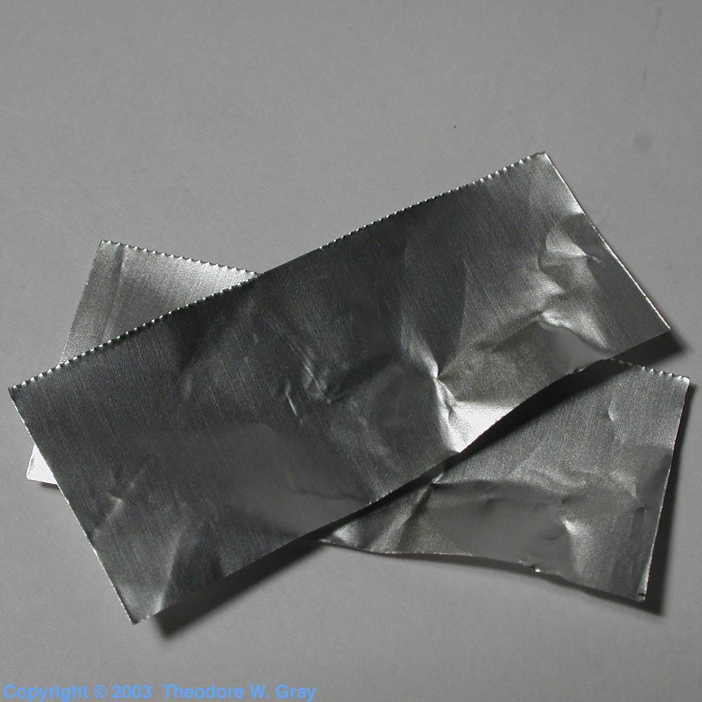
Malleable
metals can be hammered into sheets

Slide 11

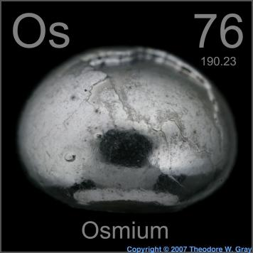
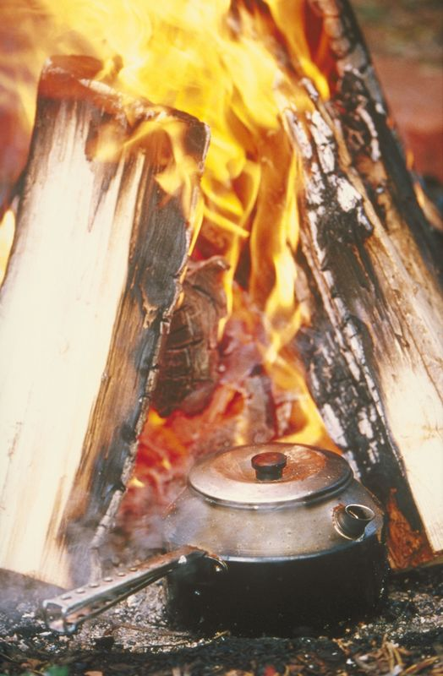
Metals have a high melting point.
They are also very dense.

Slide 12

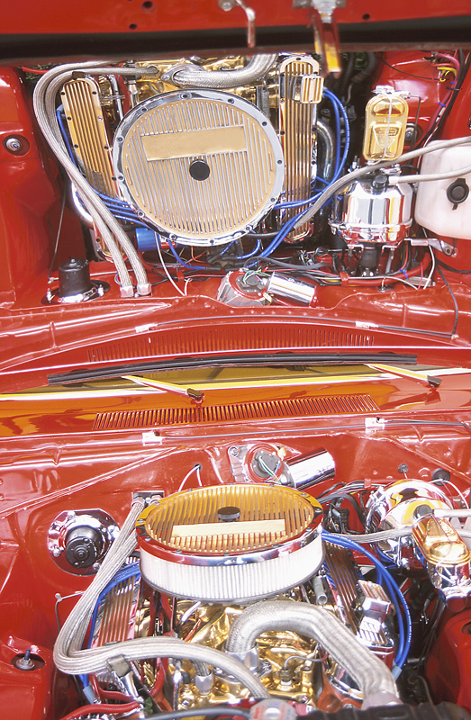
Conductors:
Metals are good conductors of electricity and heat

Slide 13
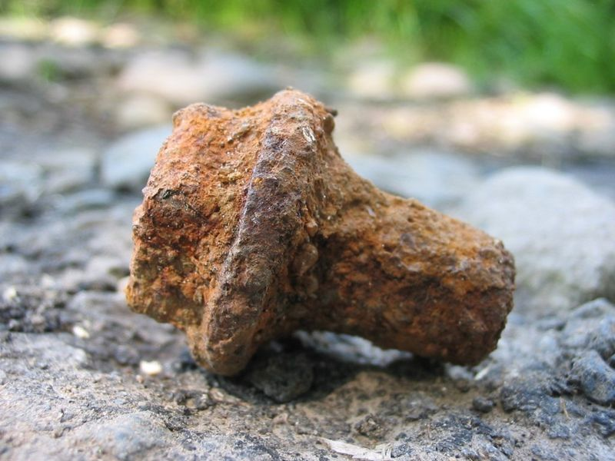
A chemical property of metal is its reaction with water and oxygen.
This results in corrosion and rust.

Slide 14

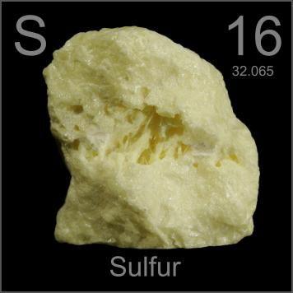
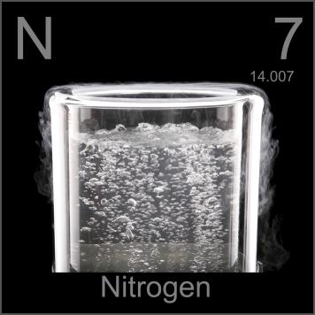
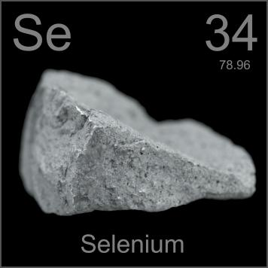
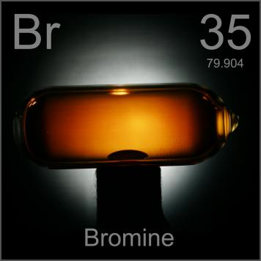

Slide 15

Nonmetals occur to the right of the dark zig-zag on the periodic table.
Although Hydrogen is in family 1, it is also a nonmetal.
Many nonmetals are gases at room temperature.

Slide 16

Nonmetals do not have luster; they are dull.

Slide 17
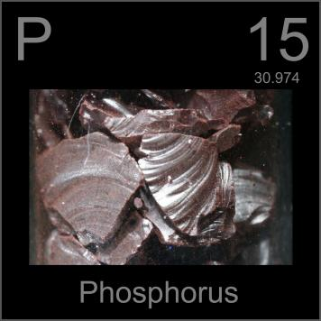
Brittle:
Nonmetals are brittle so they break easily.
This means nonmetals ARE NOT ductile or malleable.

Slide 18
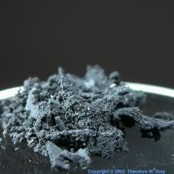
Nonmetals have low density.

Slide 19
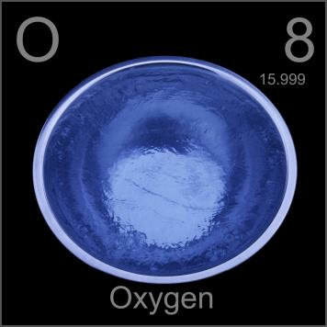
They also have a low melting point.
This is why they are poor conductors of heat and electricity.

Slide 20

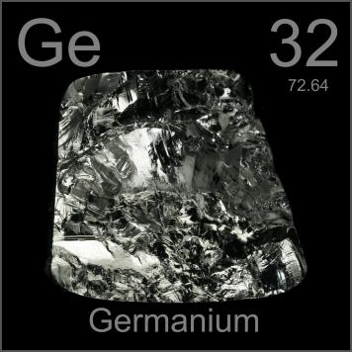
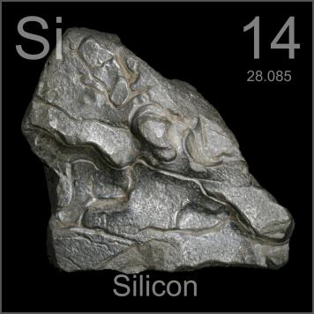
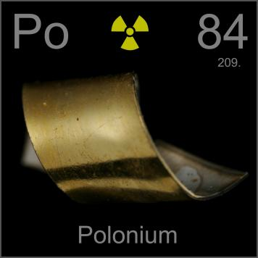
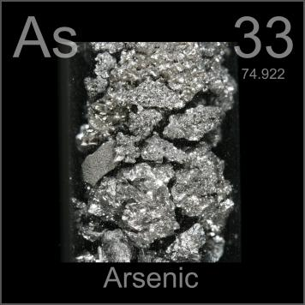

Slide 21

Metalloids can be found clustered around the dark zig-zag line that separates metals and nonmetals.

Slide 22
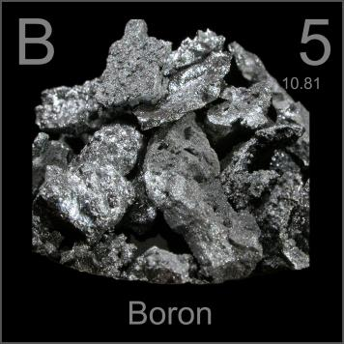
Metalloids (metal-like) have properties of both metals and nonmetals.

Slide 23
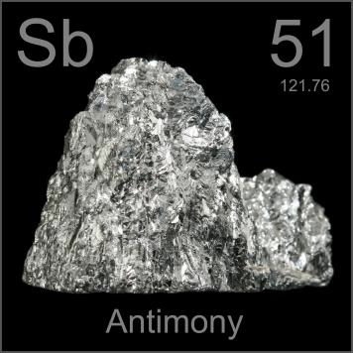
Metalloids are solids that can be shiny or dull.

Slide 24

They conduct electricity and heat better than nonmetals but not as well as metals.

Slide 25

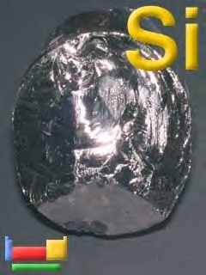
Metalloids are malleable and ductile

Slide 26
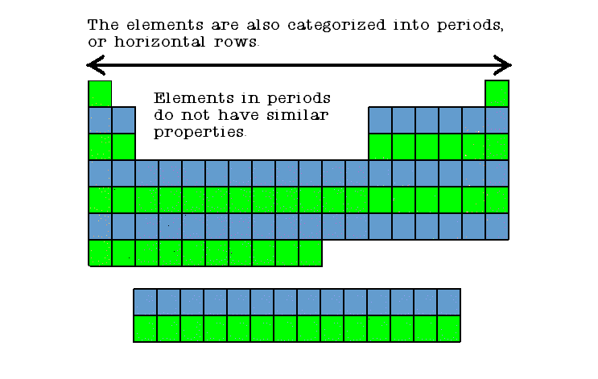

Slide 27
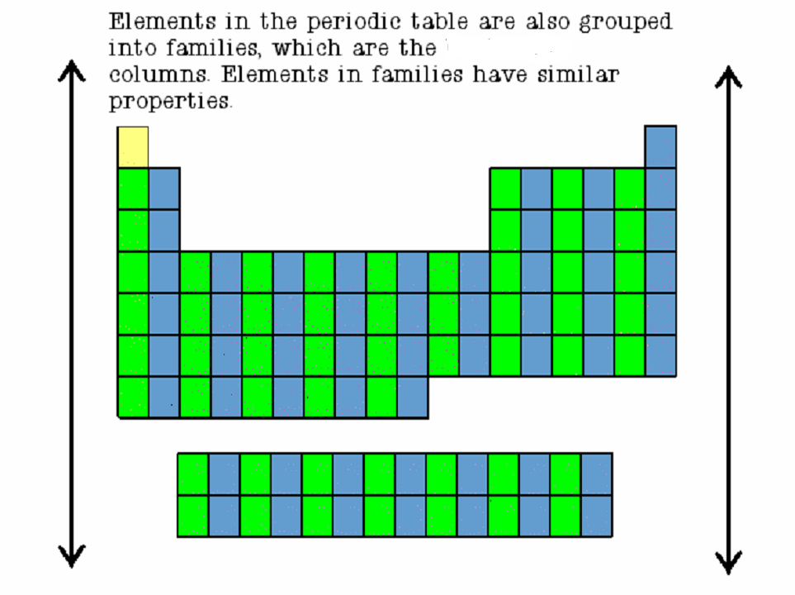

Slide 28

Families in the periodic table share chemical properties because all elements in a family have the same number of valence electrons
This means that all elements in a family bond with other atoms in a similar way.

Slide 29

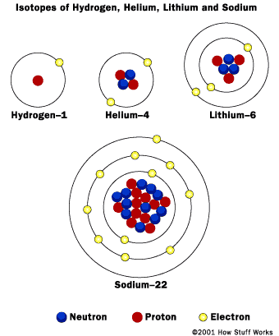
Most metals have 3 or less valence electrons and therefore are likely to lose these electrons in chemical bonds.

Slide 30
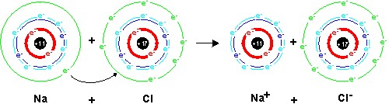
Nonmetals have 5 or more valence electrons and therefore usually gain electrons in chemical bonds.

